Slide 1
1st Substantial Amendment to CDBG-Mitigation Action Plan Public Hearing
July 12, 2023
St. Croix, University of the Virgin Islands (UVI) Great Hall
5:30 – 7:30PM
July 19, 2023
St. Thomas, UVI Administration & Conference Center
5:30 – 7:30PM

Slide 2
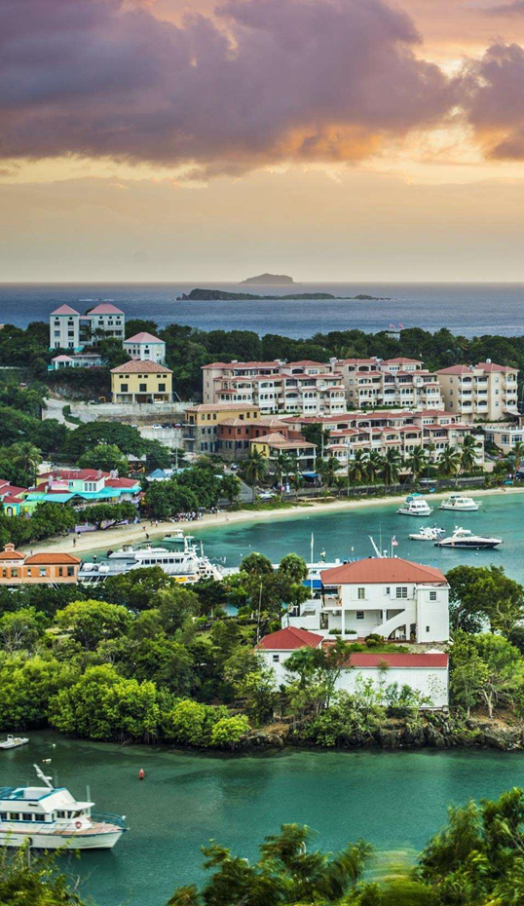
Presenters
Monee Edwards
VIHFA, Public Information Officer
Ann Hanley
VIHFA, DR Director of Programs
Anne-Marie Williams
VIHFA, Infrastructure Program Specialists
Odari Thomas
VIHFA, DR Staff Engineer
2

Slide 3
Public Hearing Goals
Provide the community an opportunity to:
LEARN
Mitigation
Eligibility Requirements
Action Plan Amendment
Covered Projects
ASK
Questions and provide input regarding the proposed substantial amendment
PUBLIC INPUT PROCESS:
Verbal comments are encouraged at the end of the presentation; comments will be accepted here at the hearing or in writing.
Written comments can be sent to the following address:
Email: media@vihfa.gov
Please label your comments: Substantial Amendment 1 – CDBG -MIT Action Plan
3

Slide 4
CDBG-MIT
Federal Register Notice (FRN) Vol. 84, No 169 published August 30, 2019, and FRN, Vol. 84, No. 175 published September 10, 2019.
Per FRN, VIHFA will conduct three (3) public hearings; one (1) convened prior to the Action Plan Publication.
US Department of Housing and Urban Development (HUD) allocated $774,188,000 in CDBG-MIT funds: (a) territorial mitigation and (b) resilience improvements.
CDBG-MIT Grant Agreement is effective, April 25, 2023.
Proposed Substantial Amendment to Action Plan.

Slide 5
Mitigation Activity, Definition
Activities that increase resilience to disasters and eliminate long-term risk of loss of life, injury, damage to and loss of property, and suffering and hardship by lessening the impact of future disasters.
* CDBG-MIT requirements are established in 84 FR 45838 (CDBG-MIT Main Notice) and 85 FR 2676.

Slide 6
CDBG-MIT Activity Requirements
Meet the definition of a Mitigation Activity
Address current and future risks identified in the U.S. Virgin Islands Hazard Mitigation Plan 2019 - Update (vi.gov)
CDBG-eligibility activities under Title I of the Housing and Community Development Act 1974 (HCDA)
* Meet a HUD National Objective
1
2
3
4
* Additional criteria for Cover Projects

Slide 7
Mitigation Needs Assessment (MNA)
U.S. 2019 Virgin Islands Hazard Mitigation Plan
Territory’s approved Hazard Mitigation Plan
Incorporated into the CDBG-MIT Action Plan
Identifies 7 critical Services Areas or Community Lifelines

Slide 8
CDBG-MIT National Objectives
Demonstrate or Consistent with¹:
Low-to-Moderate Income (LMI)
50% of grant funds shall benefit the most impacted and distressed (MID) areas.
Urgent Need Mitigation (UNM)
Address current and future risks identified in MNA.
Result in measurable and verifiable reduction in the risk of loss of life and property.
Ability to operate for the useful life of the project
Consistent with other mitigation activities that will be carried out
¹Main Notice , Section V.a.13.a.b.c.d.e.f.

Slide 9
CDBG-MIT FUNDS
Mitigation Activities
Activity Categories
Infrastructure and Public Facilities
Economic Revitalization
Planning
& Grant Administration
Housing
Strategic activities to minimize, mitigate or eliminate risks and reduce losses from future disasters.
An opportunity to improve local planning protocols and procedures in the Territory.

Slide 10
MIT Project Considerations
LMI
Mitigation
Lifelines
Does the Project Benefit
LMI Population?
What hazard(s) will the project mitigate and how will it mitigate?
How will the project support a Community Lifeline during a hazard event?
Does the benefit outweigh the cost over the life of the project?
Does the recipient have the capacity to implement the project?
Will additional funding be required to maintain the project over the full project life?
v
Benefit Cost
Implementation
Sustainability

Slide 11
Activity Allocation
Activity Category | Project Allocation | % of Total Allocation
Infrastructure and Public Facilities | $418,200,000 | 54%
Economic Resilience and Revitalization | $76,750,000 | 10%
Housing | $192,700,000 | 25%
Public Services | $15,400,000 | 2%
Planning | $32,428,600 | 4%
Administration | $38,709,400 | 5%
Total | $774,188,00 | 100%
Expenditure Timelines:
50% 6 years ( 2029)
100% 12 years (2035)
11

Slide 12
CDBG-MIT Action Plan (MIT-AP) Amendment

Slide 13
Substantial Amendment
Details the proposed use of all funds
Benefits or Eligibility Criteria | Project Activities | Allocation Thresholds | Covered Projects
Change in the program benefit or eligibility criteria | Addition or deletion of an activity | Change to the allocation or reallocation of monetary thresholds | Addition of eligible cover projects

Slide 14
Covered Projects, Definition
An infrastructure project having a total project cost of $100 Million or more, with at least $50 Million of CDBG funds (regardless of source).
All new Infrastructure Covered Projects trigger a Substantial Amendment.

Slide 15
CDBG-MIT
COVERED PROJECTS
Identified as Critical Services and Community Lifelines in the 2019 – Update U.S. Virgin Islands Hazard Mitigation Plan.

Slide 16
Additional Criteria: Cover Project
1. Demonstrate long-term efficacy and fiscal sustainability
Ability to operate for the useful life of the project
2. Benefit the MID area
Benefits must outweigh the cost; documented by a Benefit Cost Analysis (BCA)
Demonstrate unique and concrete benefits for LMI persons
3. Consistency with other mitigation activities
Must not increase the risk of loss of life or property in a way that undermines the benefits from other uses of CDBG-MIT funds in the MID
Establish a long-term Operation and Maintenance (O&M) Plan and funding
Document measurable outcomes or reduction in risk
Main Notice: Section V.A.13.b Additional criteria for Covered Projects

Slide 17
Benefit Cost Analysis (BCA) Types
BCA result must be greater than 1 .00
1. FEMA-BCA
2. Non-FEMA BCA
BCA is completed or in progress by another Federal Agency
It addresses a non-correctable flaw in the FEMA-approved methodology
It proposes a new approach that is unavailable using the FEMA BCA Toolkit.
3. Alternative demonstration of benefits
Project must serve LMI persons or other persons that are less able to mitigate risks or respond to and recover from disasters
Alternately, BCA less than 1 must demonstrate unique and concrete benefits for LMI persons

Slide 18
Energy Lifeline
Purpose is to mitigate and solidify the efficiency of long-term operation management of the utility’s fuel supply critical to its power generation. Thereby increase, reliability and efficient generation.
18

Slide 19
Current Threats to Energy Lifeline
Equipment Failure
Aged Generation
Physical Damage
Wind-driven debris
Storm surge
Supply chain disruption
Infectious disease
Economical
Equipment Failure
Fuel Insecurity
Unreliability
Single Fuel Supplier
Vitol
Single Fuel Source
Diesel
High Fuel Costs
Lack of Redundancy

Slide 20
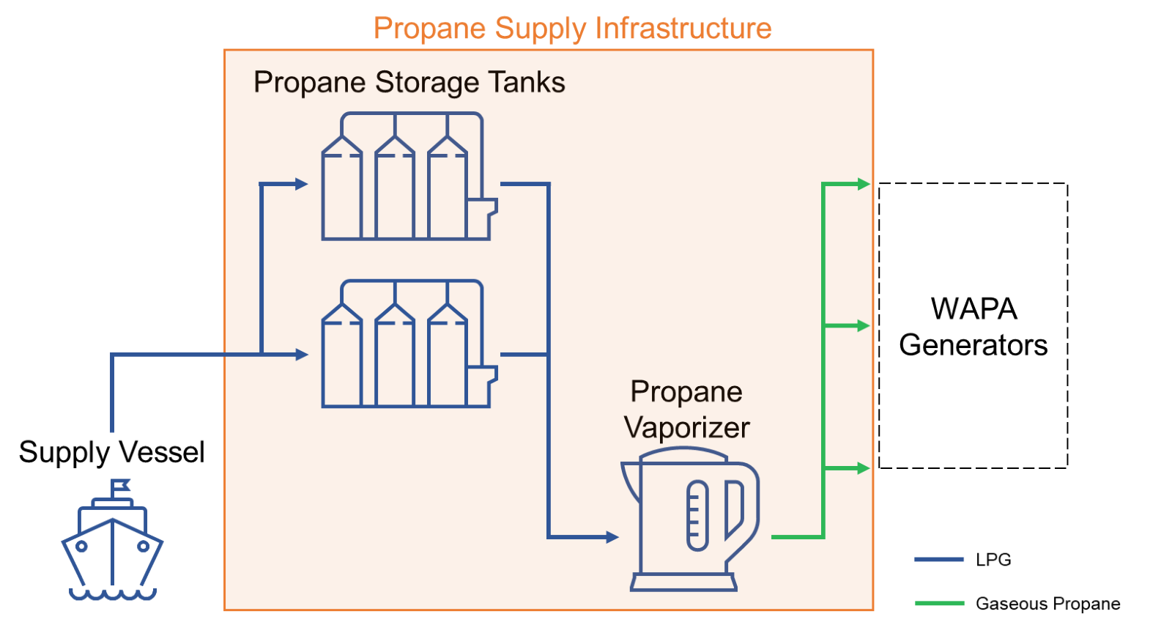
Covered Project

Slide 21
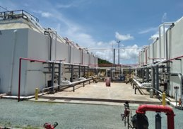
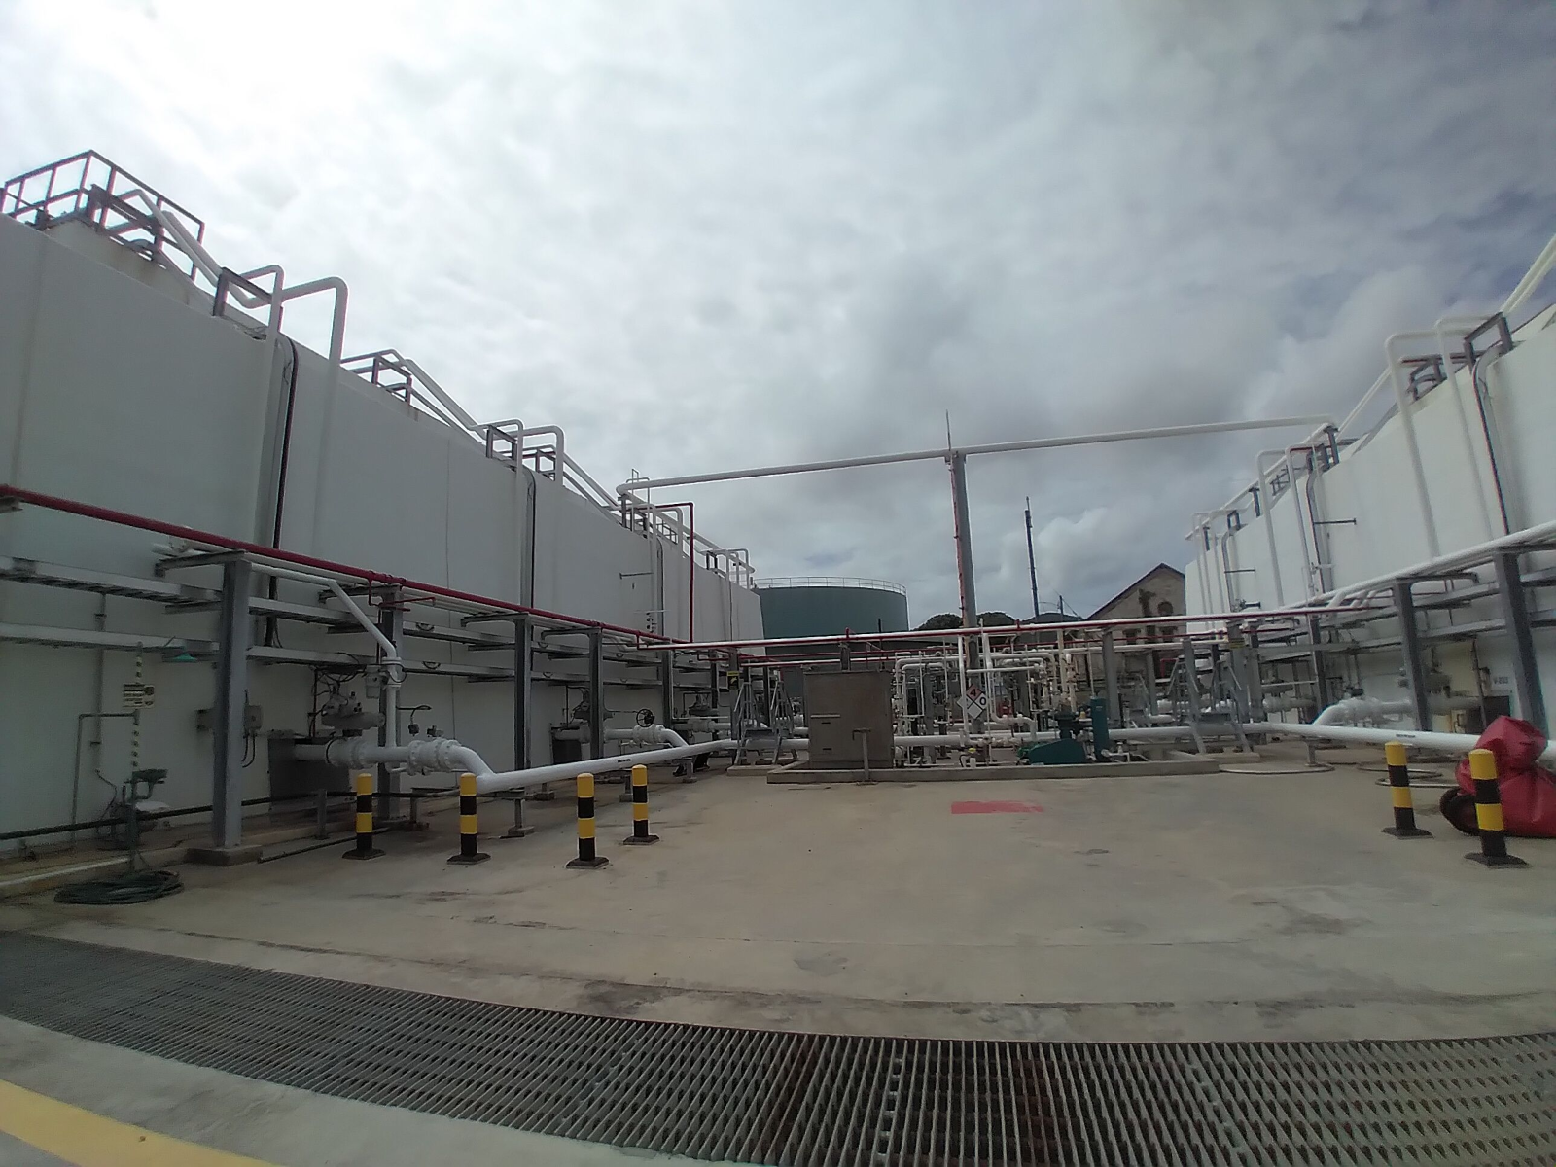
What Are We Getting?
Ownership of all propane (LPG) supply infrastructure on St. Thomas and St. Croix.
Onshore
Storage tanks
Steam system (boilers)
Piping
Truck Rack
Offshore
Mooring buoy
Breasting and mooring dolphins
Firewater Pumps
20-Year Useful Life

Slide 22
Project Cost - $145,000,000

Slide 23
Project Benefits
VITOL Acquisition
Ownership of the Propane Supply Infrastructure Mitigates Risk to the Energy Lifeline
As a Community Lifeline, the supply of propane is critical for WAPA to generate electricity and produce potable water.
Maintain Lower Fuel Costs
Lower Propane Transportation Costs
Fuel Redundancy
Fuel Security
Drinking Water Security
Improved Reliability
Improved Environmental Profile

Slide 24
Should We Do It?
BCA
Pre-Mitigation Impact
(Diesel availability)
Territorial Annual Fuel Cost - $88,200,000
Post-Mitigation Impact
(LPG & Diesel Availability)
Territorial Annual Fuel Cost (District-wide) - $38,200,000
BENEFIT COST SUMMARY
Total Mitigation Benefits = $529,700,659
Total Mitigation Project Cost = $361,117,891
BCR = 1.47

Slide 25
Is It A Fit For MIT?
MIT PROJECT
Resilient
(Bunkered fuel)
Addresses Risks
(MNA)
Eligibility (Acquisition)
National Objective
(UNM)

Slide 26
Is It A Fit For MIT?
LONG-TERM O&M Plan
BENEFITS
(BCR = 1.47)
MIT Consistency
(Lifeline)
COVERED PROJECT
MIT PROJECT
Cost =
+$100M

Slide 27
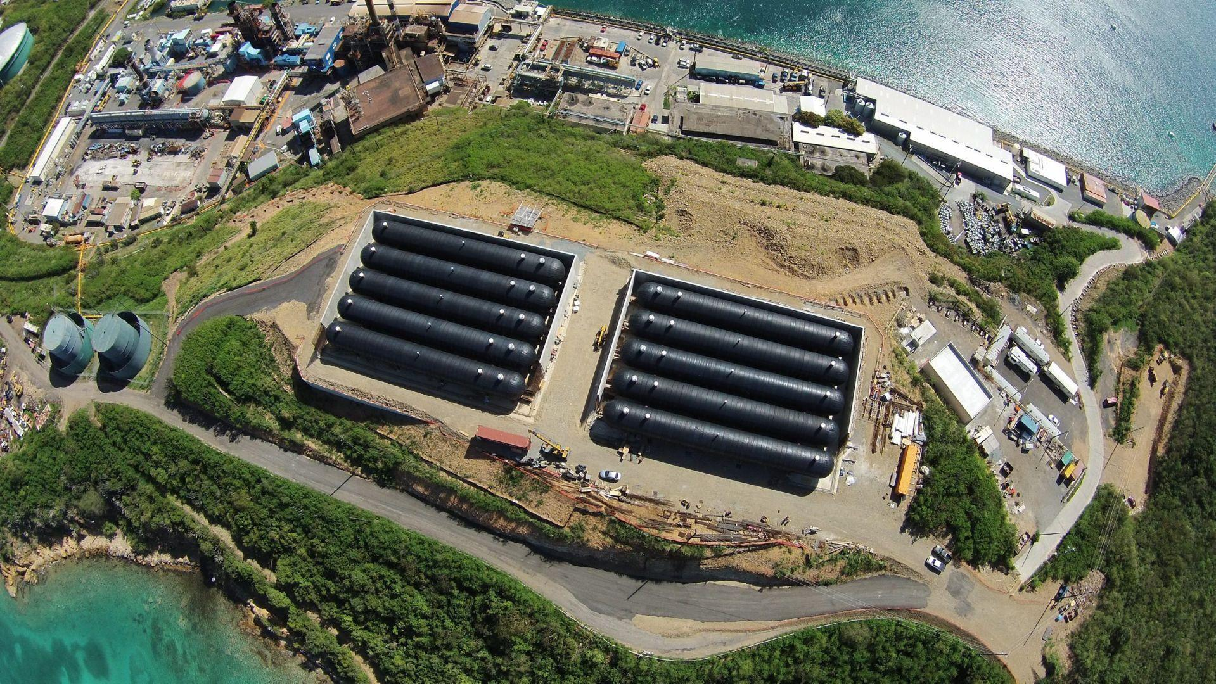
Will It Work?
Resilient fuel capacity
Operations and maintenance*
18 Fuel Tanks in concrete bunkers
STT Fuel Supply Increase
27 days
STX Fuel Supply Increase
20 days
Additional fuel supply point (Offshore Mooring Buoy)
Additional fuel dispensing point (Truck rack)
Limited moving equipment
Forecasted O&M budget for remainder of useful life to aid planning
3rd-party operator to operate and maintain facility
* Operations and maintenance costs are not eligible for CDBG-MIT funding

Slide 28
Public Engagement
JUN I THU
June 29, 2023
1st Public Hearing
Pre-Action Plan Publication
29
JUL I THU
July 6, 2023
30-Day Comment Period Opens
06
JUL I WED
July 12, 2023
2nd Public Hearing
12
JUL I WED
July 19, 2023
3rd Public Hearing
19

Slide 29
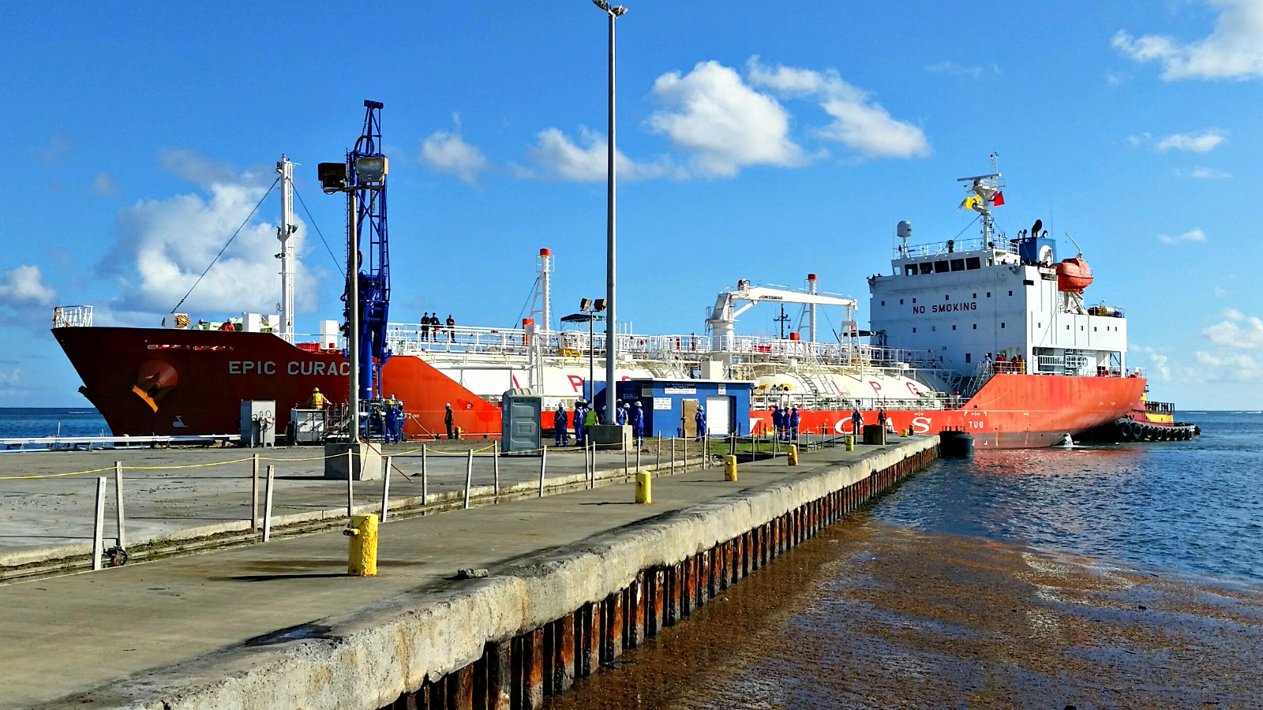
Public Engagement Continued…
AUG I MON
August 7, 2023
Last Day for Public Comments
30-Day Comment Period Ends
07
AUG| FRI
August 12, 2023
Action Plan Amendment 1 Submitted to HUD for Approval
12

Slide 30
Public Comments
Individuals who wish to provide public comments at one of the hearings will each be given three minutes to speak.
Those wishing to speak are encouraged to provide a written copy of their comments to VIHFA staff.
All written comments can be submitted by:
Email: media@vihfa.gov
Please label your comments: Substantial Amendment 1 - CDBG-MIT Action Plan
For additional information, please visit VIHFA’s website at: https://cdbgdr.vihfa.gov/programs/cdbg-mitigation/

Slide 31
Thank You!

